Slide 1
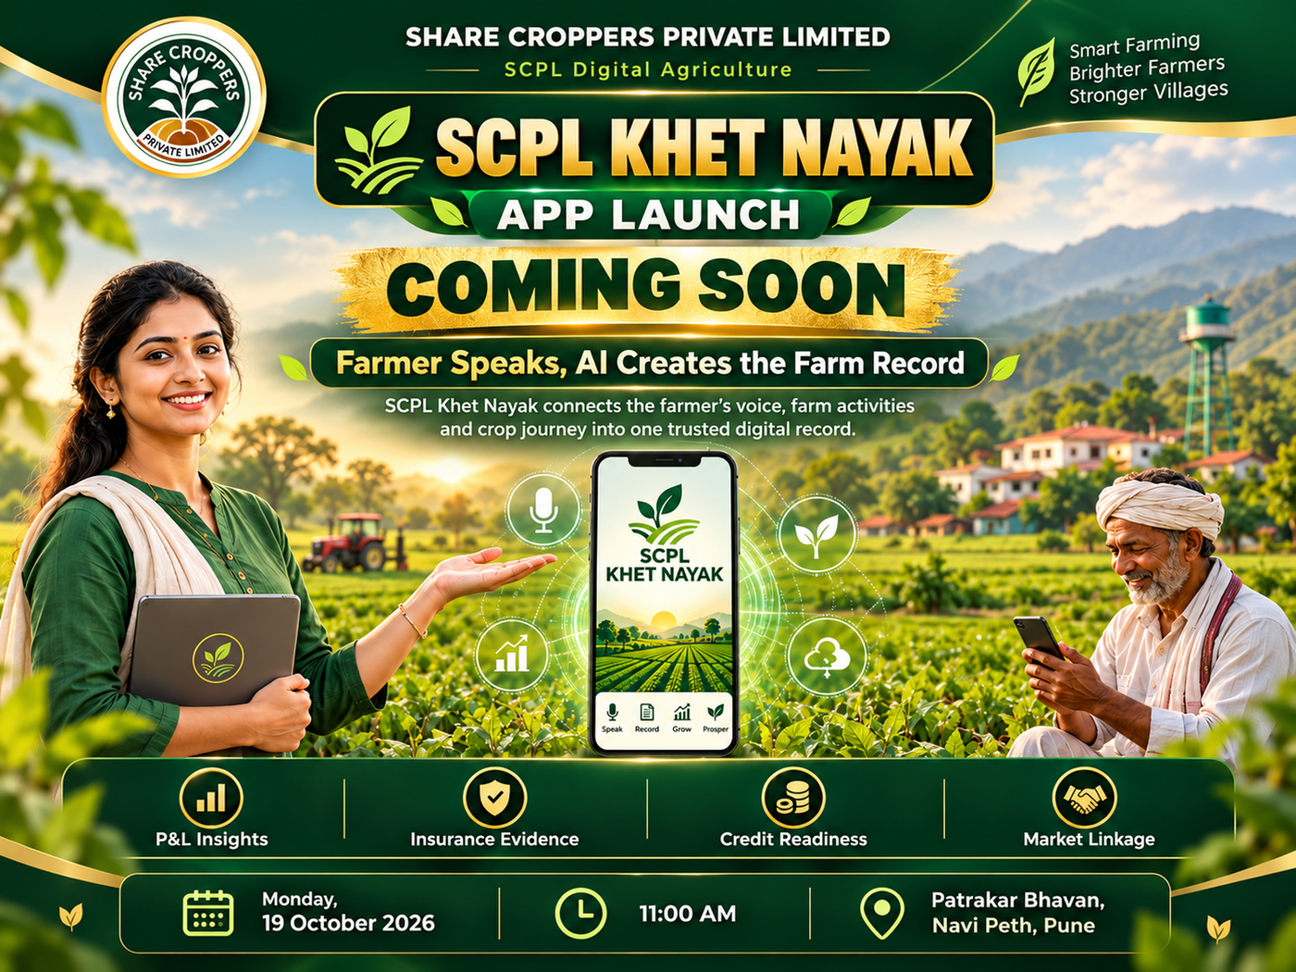
SCPL
Digital Agriculture
SCPL KHET NAYAK
App Launch
Farmer Speaks. AI Creates the Farm Record.
Press Conference & Launch Ceremony
19 October 2026 • 11:00 AM
Patrakar Bhavan, Navi Peth, Pune
Records → Evidence → Decisions → Services → Markets
Share Croppers Private Limited • SCPL Digital Agriculture • www.sharecroppers.in
01

Slide 2
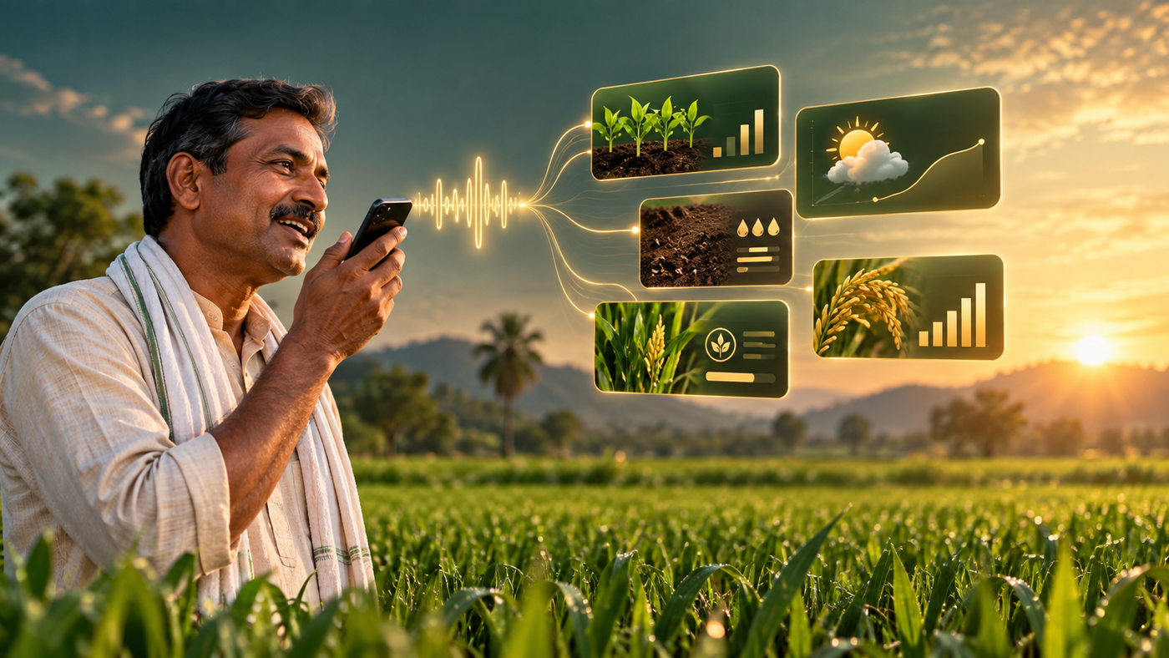
SCPL
Digital Agriculture
PRODUCT IDEA
A farmer should not become a data-entry operator.
Khet Nayak turns local-language voice, photos and bills into a structured digital farm record.
🎙️
Voice-first
Farmers can speak updates instead of typing long forms.
📸
Evidence-first
Crop photos, bills and activity records become part of a season file.
📈
Decision-first
Data supports P&L, insurance, credit and market linkage.
Share Croppers Private Limited • SCPL Digital Agriculture • www.sharecroppers.in
02

Slide 3
SCPL
Digital Agriculture
Farmer Speaks → AI Creates → FarmerFriend Verifies
A simple workflow designed for field reality — not office-style data entry.
1
Farmer voice / photo
2
AI micro-record
3
Smart Inbox review
4
Trusted season file
Local language update from the field
Structured draft: activity, date, plot, cost
FarmerFriend approves, corrects or flags
Ready for P&L, credit, insurance and markets
Share Croppers Private Limited • SCPL Digital Agriculture • www.sharecroppers.in
03

Slide 4
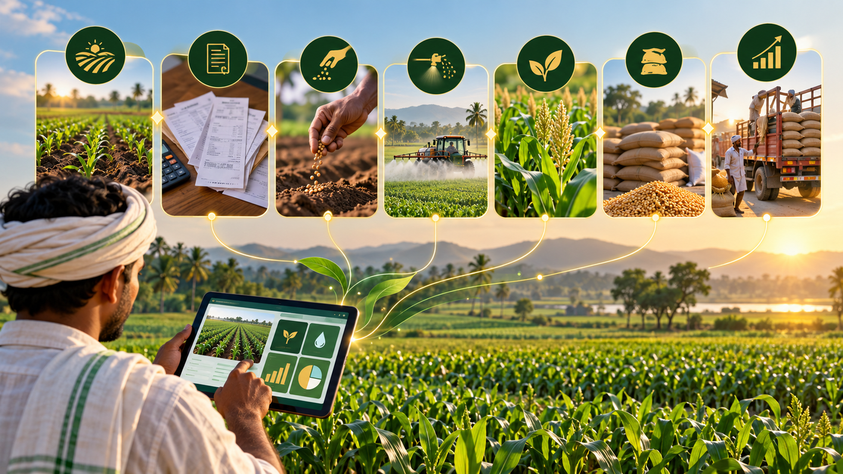
SCPL
Digital Agriculture
CORE CAPABILITIES
One app for the crop journey.
From sowing to sale, each field activity can become part of a trusted record.
Land & plot records
Sowing
Spraying
Expenses
Crop photos
Production
Sales
Share Croppers Private Limited • SCPL Digital Agriculture • www.sharecroppers.in
04

Slide 5
SCPL
Digital Agriculture
Digital Farm Record
A record is useful only when it links farmer, land, plot, crop cycle and activities.
1
Farmer ID
Owner, mobile, KYC, village
2
Land & Plot
7/12, polygon, crop area
3
Crop Cycle
Sowing, variety, dates
4
Activities
Spray, labour, inputs, machinery
5
Outcome
Production, sale, P&L
Share Croppers Private Limited • SCPL Digital Agriculture • www.sharecroppers.in
05

Slide 6
SCPL
Digital Agriculture
FARMER BENEFITS
What the farmer gains each season.
Khet Nayak converts field activity into usable evidence and decisions.
📊
P&L Insights
🛡️
Insurance Evidence
Know real cost of cultivation, production value and season-wise profitability.
Crop photos and activity records support better documentation during claims.
🏦
Credit Readiness
🤝
Market Linkage
A structured Farmer Season File helps banks understand real farm activity.
Pre-harvest crop data helps connect production to buyers more systematically.
Share Croppers Private Limited • SCPL Digital Agriculture • www.sharecroppers.in
06

Slide 7

SCPL
Digital Agriculture
FarmerFriend Smart Inbox
AI prepares the record. FarmerFriend makes it trusted.
APPROVE
CORRECT
Clean record ready to post
Fix plot, crop, amount or date
FLAG
ATTACH
Needs clarification
Bills, photos and evidence
Share Croppers Private Limited • SCPL Digital Agriculture • www.sharecroppers.in
07

Slide 8
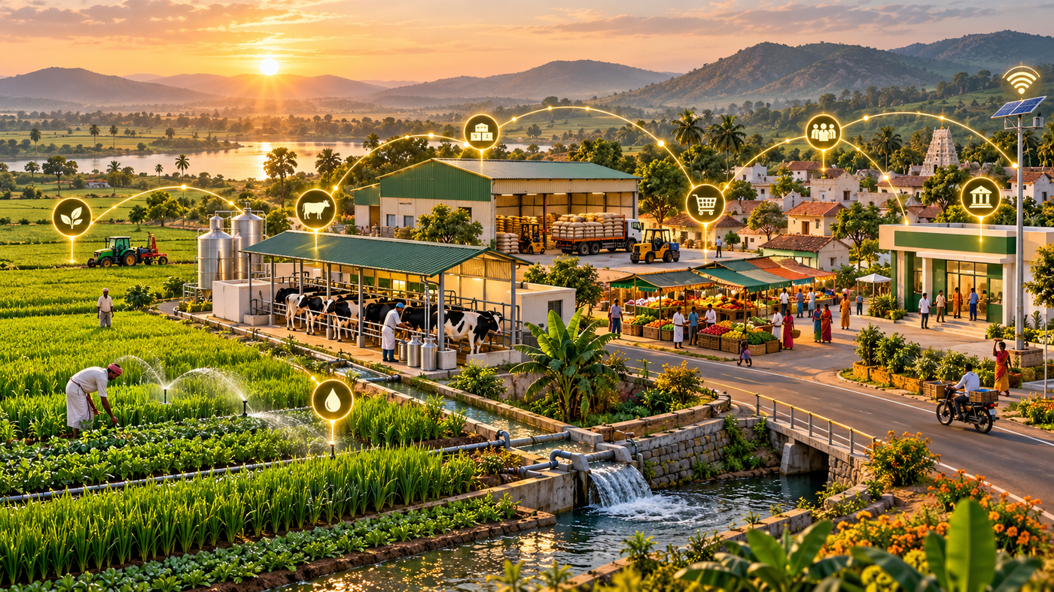
SCPL
Digital Agriculture
SCPL SERVICE WINDOW
Records are the foundation for services.
A trusted digital record unlocks practical farmer support.
Input Aggregation
Machinery on Fuel Cost
Insurance Evidence
Credit Readiness
Market Linkage
Share Croppers Private Limited • SCPL Digital Agriculture • www.sharecroppers.in
08

Slide 9
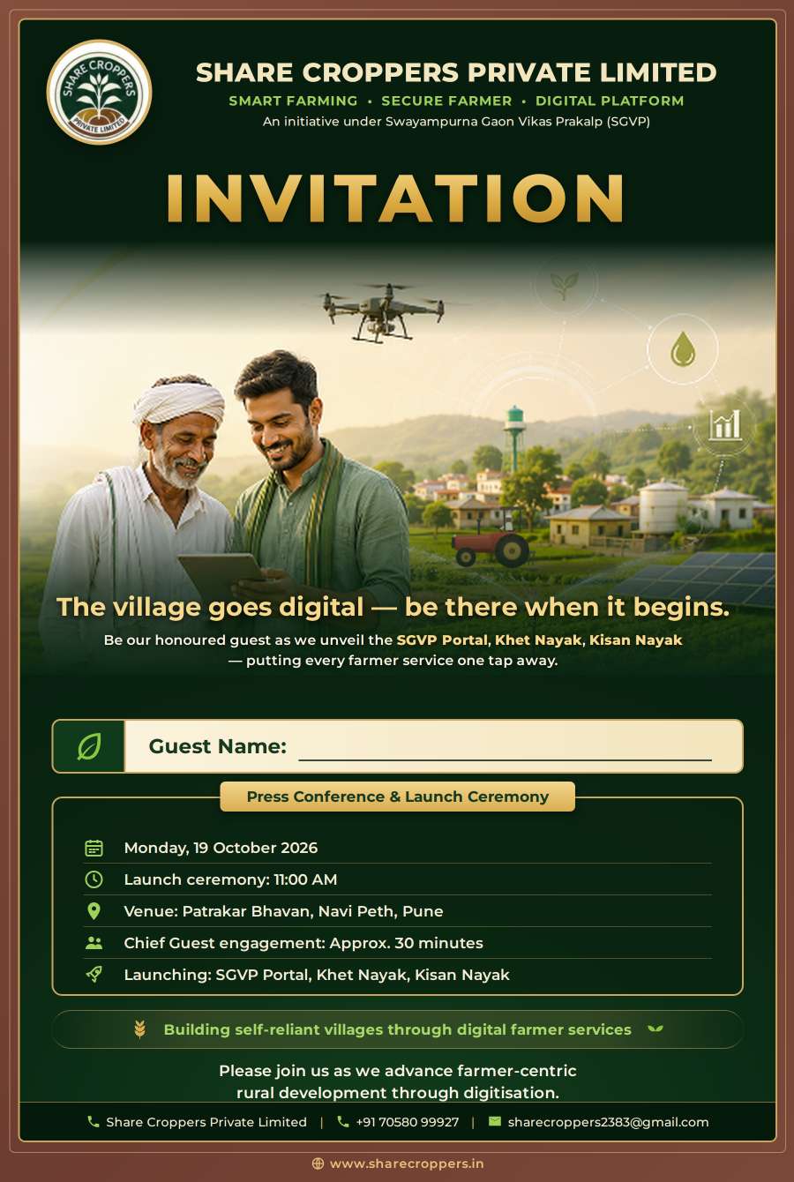
SCPL
Digital Agriculture
Launch Ceremony
Press Conference & Launch Ceremony
DATE
Monday, 19 Oct 2026
TIME
11:00 AM
VENUE
Patrakar Bhavan, Navi Peth, Pune
Share Croppers Private Limited • SCPL Digital Agriculture • www.sharecroppers.in
09

Slide 10
SCPL
Digital Agriculture
WEBSITE EVENT EXPERIENCE
Cover first. Actions visible. Details clean.
The live Events page should make the Khet Nayak launch easy to view, share and explore.
SCPL Khet Nayak App Launch
19 Oct 2026 • 11:00 AM
Patrakar Bhavan, Navi Peth, Pune
View Event
Presentation
PDF
Video
Map
Buttons appear only when files or links are uploaded.
Share Croppers Private Limited • SCPL Digital Agriculture • www.sharecroppers.in
10

Slide 11
SCPL
Digital Agriculture
Khet Nayak is more than an app.
It is the farmer-facing window into a connected village operating system.
Records
Evidence
Decisions
Services
Markets
Swayampurna Gaon Vikas Prakalp
Building self-reliant villages through digital farmer services.
Share Croppers Private Limited • SCPL Digital Agriculture • www.sharecroppers.in
11

Slide 12
SCPL
Digital Agriculture
Join the Khet Nayak launch journey
Smart Farming • Secure Farmer • Digital Platform
WEBSITE
www.sharecroppers.in
CONTACT
+91 70580 99927
EMAIL
sharecroppers2383@gmail.com
Farmer Speaks.
AI Creates.
Farmer Benefits.
Share Croppers Private Limited • SCPL Digital Agriculture • www.sharecroppers.in
12

